Slide 1


Pedibus Development
March 20, 2014
Sponsored by Capital City Pedicab Company
In affiliation with the FSU and FAMU College of Engineering
Team 18:
John Hassler
Andrew Galan
James McCord
Onyewuchi Ebere
Sponsor: Instructor:
Ron Goldstein Dr. Kamal Amin
Faculty Advisors:
Dr. Chiang Shih
Dr. Patrick Hollis

Slide 2
Brief Overview
A pedibus is a pedal-powered vehicle used for public and private transportation that seats a variety number of passengers depending on size.
The idea is to develop and provide an eco-friendly and environmental safe traveling entertainment center to attract people of all ages and professions.
        Some models contain alcohol distribution consoles in the center, as well as other forms of interest.
Also referred to as a pedal crawler, pubcrawler, and most commonly the party bike.
Our goal: Provide Capital City Pedicabs and owner Ron Goldstein with a fully-operating pedibus prototype that will be used as a guideline for future manufacturing and reproduction; as well as fundamental and marketing purposes.
James McCord

Slide 3
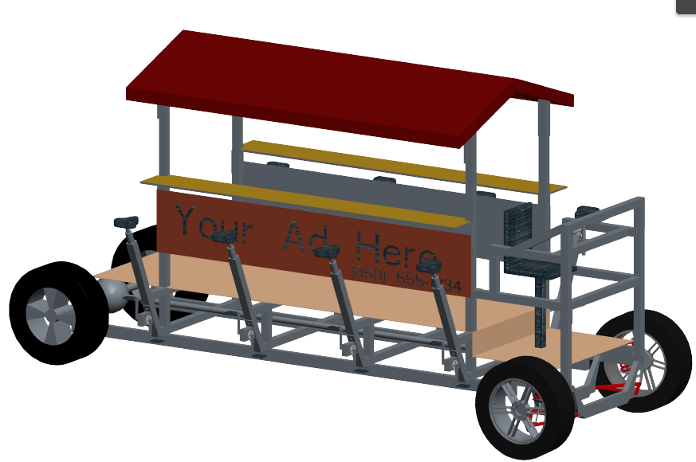
Design Process
The structural design and dynamic analysis of the pedibus prototype was evaluated during the fall semester.
The initial design was broken down into three stages:
  Structural Frame
  Steering and Braking
  Power Generation and Efficiency
The final design consist of eight pedaling stations, an independent front suspension and braking system, manual rack-and-pinion steering, and a central walk way for entertainment needs.
Figure does not replicate final prototype.
James McCord

Slide 4
Final Design Features
The Pedibus will include:
  8 passenger pedaling stations.
  1 driver station located at the front that includes steering and braking.
  Additional room for standing passengers.
  An estimated maximum speed of 7 mph.
  Independent front suspension
  Adjustable seat and bar height
  Easy maintenance
  An enjoyable atmosphere
James McCord

Slide 5
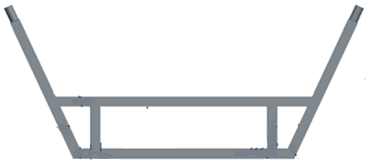
Common Nomenclature for pedibus parts
Seat Post Collar
Cross Member
Steel Support
James McCord

Slide 6
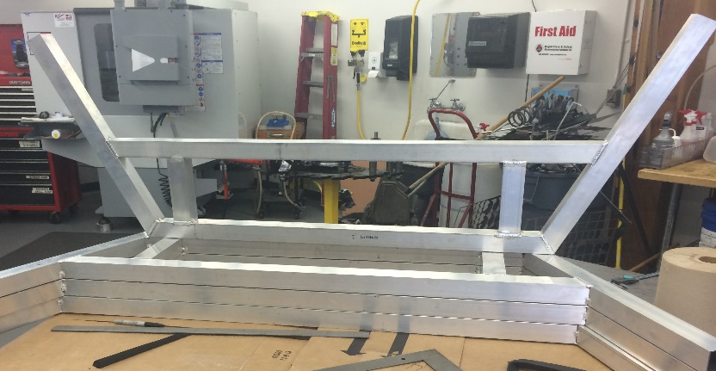
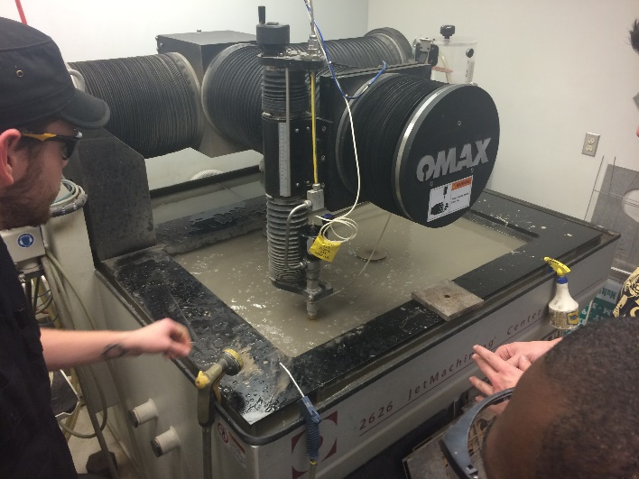
Current Progress
Finalizing the machining and beginning the assembly has been the main objective of this semester up to this point.
The final structural design has been implemented, as well as pedaling station assembly.
Currently, individual components are in the final stage of production in the machine shop. Several parts have already been assembled and completed, including the aluminum cross members.
Onyewuchi Ebere

Slide 7
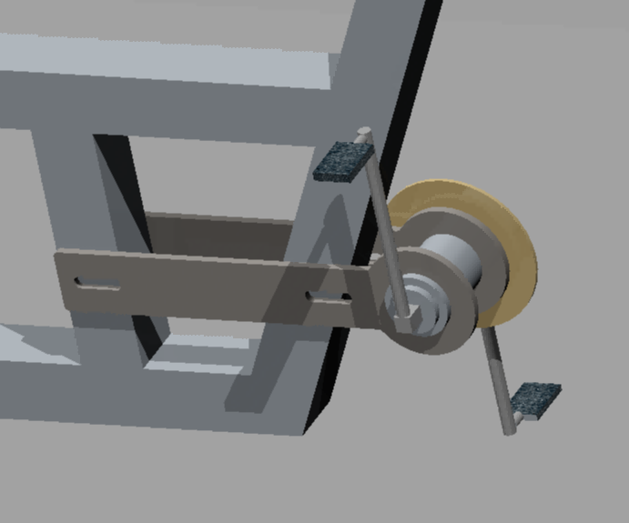
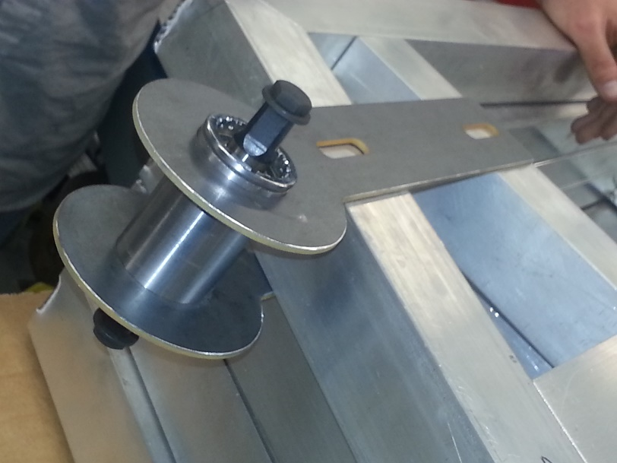
New Pedaling Crank Design Implementation
The chain service life is prolonged
The chain that will be fitted need not be same size as others
The new design incorporates chain adjusting means.
The chain tensions are independent.
The new design
The fabricated pedaling station
Onyewuchi Ebere

Slide 8
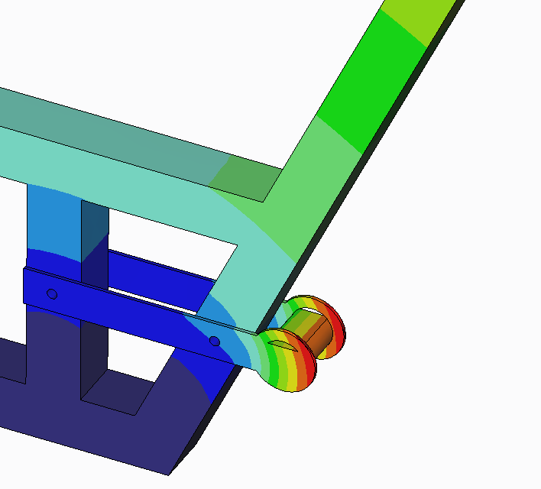
FEA Analysis That Justified The New Implemetation
FEA analysis shows that the part is strong enough to support 300 lb passenger.
Displacement of the crank was less than .001 inches
Onyewuchi Ebere

Slide 9
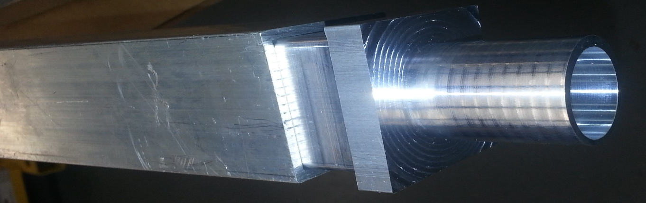

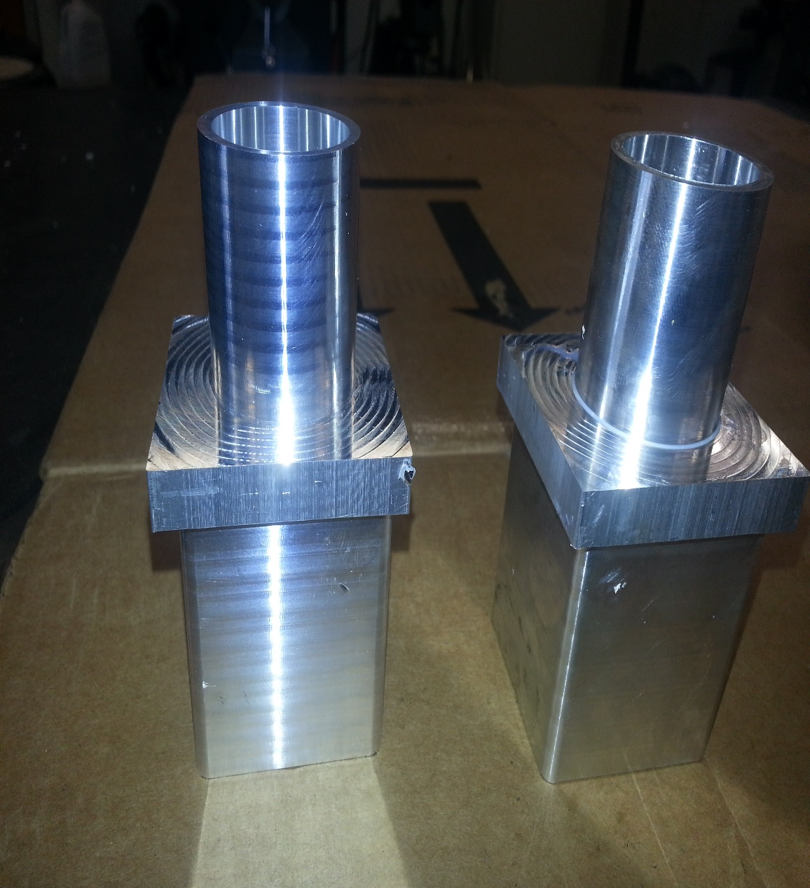
New Seat Post Attachment Design implementation
The initial seat post design
The two seat posts has the same service advantage
The adjustment was as a result of
manufacture and assembly simplicity.
collar
Seat post
Aluminum cross member
Square constrain
The seat post collar inserted into the cross member
Implemented seat post collar design
Onyewuchi Ebere

Slide 10
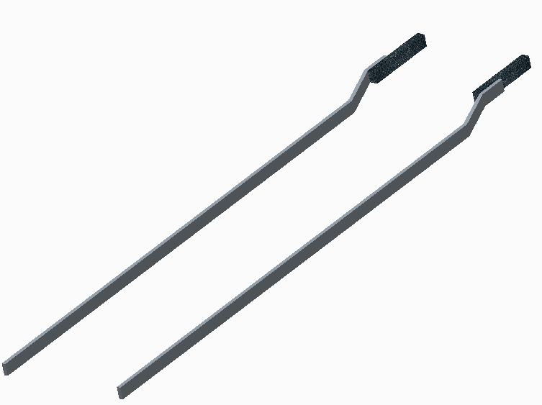
Steel Support Design Changes and Implementation
Original steel supports were designed to be straight 1” by 3” steel tubing
After receiving the front end it was observed that without changing the steel support design the Pedibus would be inclined from back to front.
New Steel Support Design
John Hassler

Slide 11
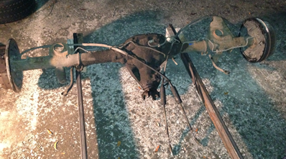
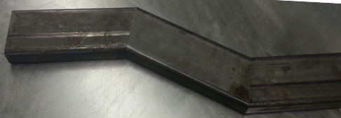
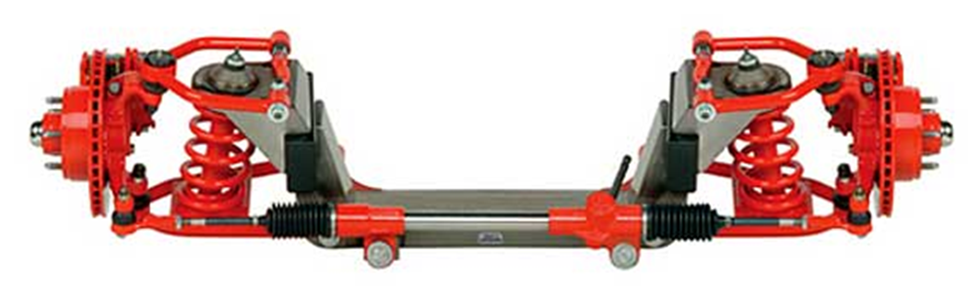
Steel Support Design Changes and Implementation
Installing the IFS without stepping up the chassis will incline the pedibus.
To prevent this from happening we stepped the chassis upward.
The upward stepped Steel Support
the supplied IFS
John Hassler

Slide 12
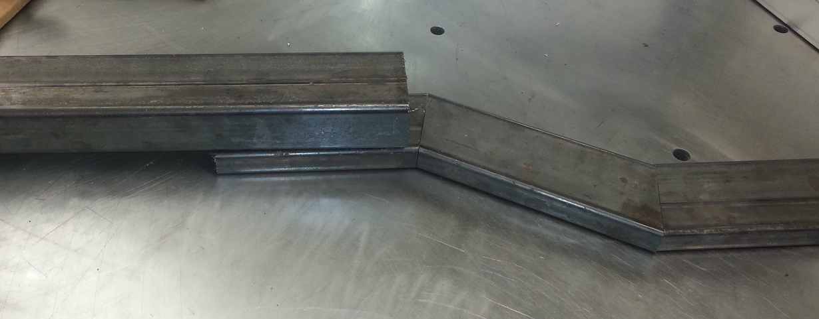
Steel Support Design Changes and Implementation
Re designing of the chassis due to changes in dimension
27in
32in
The stepped in chassis
John Hassler

Slide 13
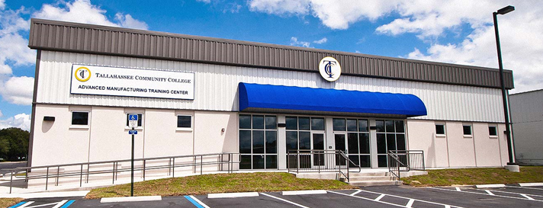

Manufacturing and Storage Challenges
We originally thought storage and build space was available through the sponsor. We were not aware we didn’t have build space until the beginning of this semester
TCC requires an agreement be signed between FSU and TCC for us to get access to the space.
Permission for use of the storage facility has still not arrived.
    This has delayed the assembly process due to lack of room in the current storage space.
John Hassler

Slide 14
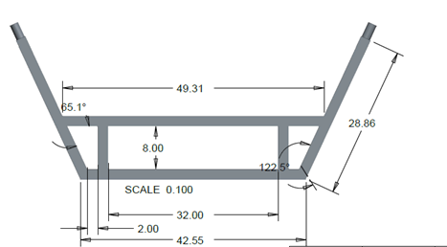
Procurement Challenges
Due to the recent winter storm and spring weather the vendor of the IFS, located in Iowa, has experienced delays in shipping
The dampers had to be resent due to shipping error.
The weld points being narrower than the initial frame design also delayed the assembly.
John Hassler

Slide 15
Remaining Time has become a Potential Challenge
Only four weeks left to complete the Pedibus and assembly has yet to begin.
Eight passengers makes for a big vehicle. We have over 50 parts manufactured at the machine shop.
Everything has taken longer than we anticipated and we are running out of time.
John Hassler

Slide 16
In The Future
Continue assembly of the structural frame and mechanical components.
Perform more dynamic and static load testing to ensure safety of prototype once built.
Begin the assembly of the Pedibus’ central drive train.
Continue to keep in contact with the sponsor.
Prepare for prototype demonstration and open house.
Andrew Galan

Slide 17
Future Testing and Analysis
Once the pedibus prototype has been completely assembled, testing and analysis of individual components will begin.
These components and test include:
    Structural Frame
      Ensure the frame is structurally sound
    Drive train
      Ensure the cruising speed of 7mph is achievable
      Ensure the cadence at the cruising speed is comfortable
    Steering and braking
      Ensure the Pedibus is easy to steer and has the breaking force necessary to stop the vehicle safely
Andrew Galan

Slide 18
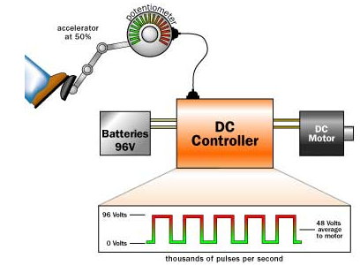
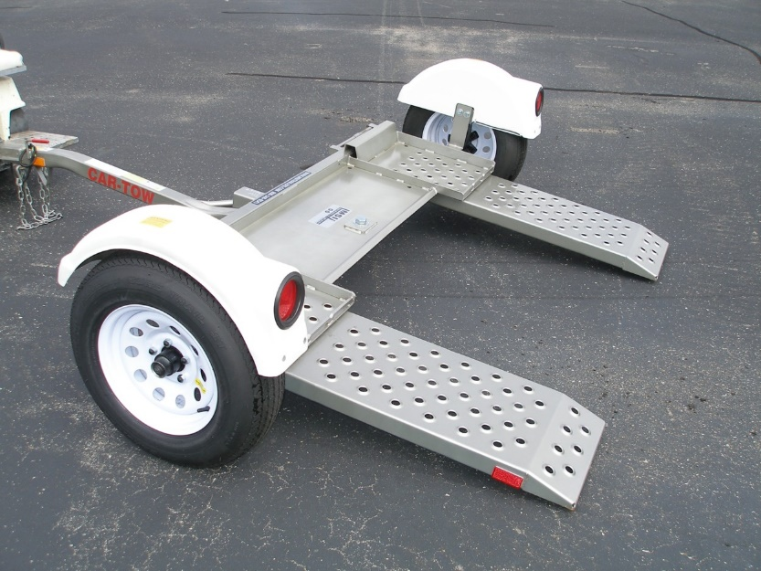
Transportation Method
With the removal of the power assistance due to time and cost constraints, the pedibus will now be manually transported when traveling long distances.
The design of the prototype will still be open to a power assist unit installation if one is desired to be implemented in the future.
The pedibus shall be transported using a trailer system. This will allow the vehicle to be transported to various parts of the Tallahassee area in an efficient time.
Andrew Galan
Notes:
Without a power assist a driver will not be able to operate the vehicle alone, so the pedibus will need to be towed to the customer pickup location via a simple car dolly until a power assist is installed
In addition to time constraints, the cost of an effective Power assist system would add upwards of 3000$ to the total cost

Slide 19
Procurement and Budget Status
BOM |  | # | Price Per Item
Steel Supports |  | 2 | $69.00 | $138.00
Aluminum Frame |  | 1 | $389.00 | $389.00
Pillow Blocks |  | 4 | $30.00 | $120.00
3/4 inch Cold Rolled Drive Shaft |  | 1 | $100.00 | $100.00
Mustang II Ifs |  | 1 | $1,350.00 | $1,350.00
Rear Axle and Differential |  | 1 | $140.00 | $140.00
Bike Crank |  | 8 | $45.00 | $360.00
Bike Seat |  | 8 | $17.00 | $136.00
Bike Chain |  | 8 | $30.00 | $240.00
Free Wheel gear |  | 8 | $25.00 | $200.00
Wheels |  | 4 | $104.00 | $416.00
Lighting Kit |  | 1 | $170.00 | $170.00
2 U Joint Steering Shaft |  | 1 | $170.00 | $170.00
U Bolts |  | 4 | $12.00 | $48.00
Brake Pedal and Master cylinder |  | 1 | $133.00 | $133.00
Bottom Bracket Shell |  | 8 | $4.25 | $34.00
Total |  |  |  | $4,092.00
All main structural and mechanical components of the pedibus have been individually sourced and purchased.
Future purchases are directly provided by the sponsor, if required.
The updated budget shows the current running cost of price for the prototype development.
Andrew Galan

Slide 20
Expected Timeline
Andrew Galan

Slide 21
Questions
?

